Slide 1
Colour Idioms

Slide 2
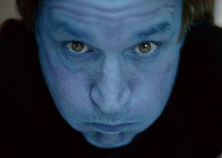
Blue
Idiom Meaning
Once in a blue moon Very rarely
To be blue To be sad
Blue blood Noble or aristocratic
descent
Blue in the face Extremely angry

Slide 3
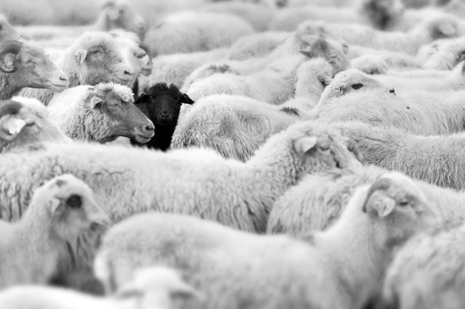
Black
Idiom Meaning
Black and blue Bruised and beaten
Black sheep Bad member of the
group
Black out Faint
Black and white Straight forward

Slide 4
Brown
Idiom Meaning
Brown as a berry Quite suntanned
Brown someone off Make someone angry
Brown-nose To try too hard to
please someone
Brown study A state of deep thought

Slide 5
Golden
Idiom Meaning
Golden opportunity The perfect chance
Golden age Best years
Golden boy/girl Someone who is
successful

Slide 6
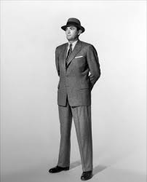
Grey
Idiom Meaning
Grey area Something without a
clear rule or answer
Grey matter Intelligence,brain
The men in grey suit Men in business or
politics

Slide 7
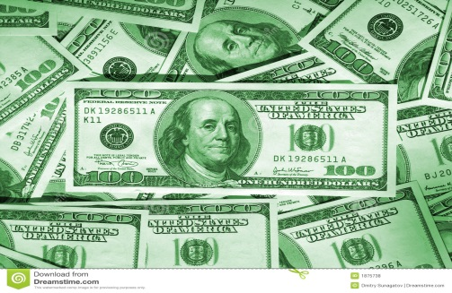
Green
Idiom Meaning
The green light Permission
Green with envy Very jealous
Have a green thumb Be skillful in the garden
Green stuff Money

Slide 8
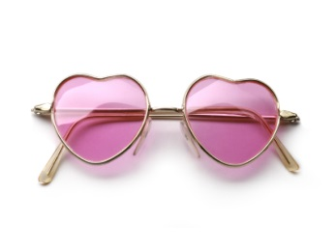
Pink
Idiom Meaning
Rose coloured glasses Unrealistic view
Tickled pink Very pleased and
appreciative
In the pink In very good health
Pink slip Atermination notice from a job

Slide 9
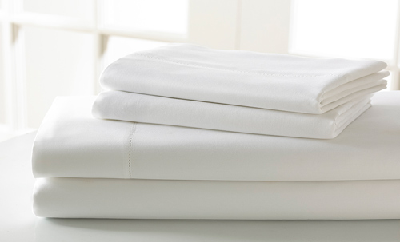
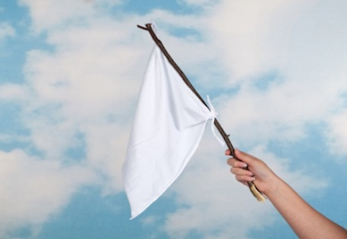
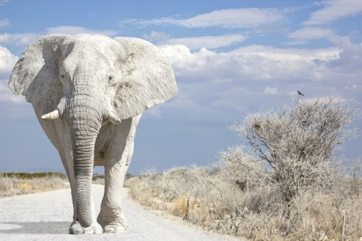
White
Idiom Meaning
White lie Harmless,small lie
White as a sheet Extremely pale
Raise a white flag To indicate that you
want to give up
White elephant A useless possession

Slide 10
Made by:Ena Domazet
8th Grade

